Slide 1
Introduction to Software Testing and TDD
Guillermo Gonzalez

Slide 2

What is Software?
Series of Instructions to perform a particular task (program)
Categories
System: Control programs (OS)
Application: Process data for the user
Development Process
Different Areas

Slide 3
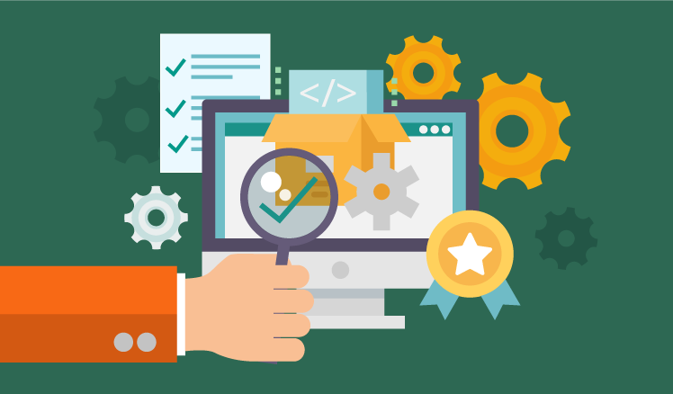
Software Quality
Degree of Excellence
High quality software usually conforms to the user requirements
Performance
Completely meets operational requirements
Compatibility
It Saves Time/Money
Less maintenance
Customer satisfaction
Quality Software is:
Reasonably bug or defect free
Delivered on time and within budget
Meets requirements and/or expectations
Maintainable

Slide 4
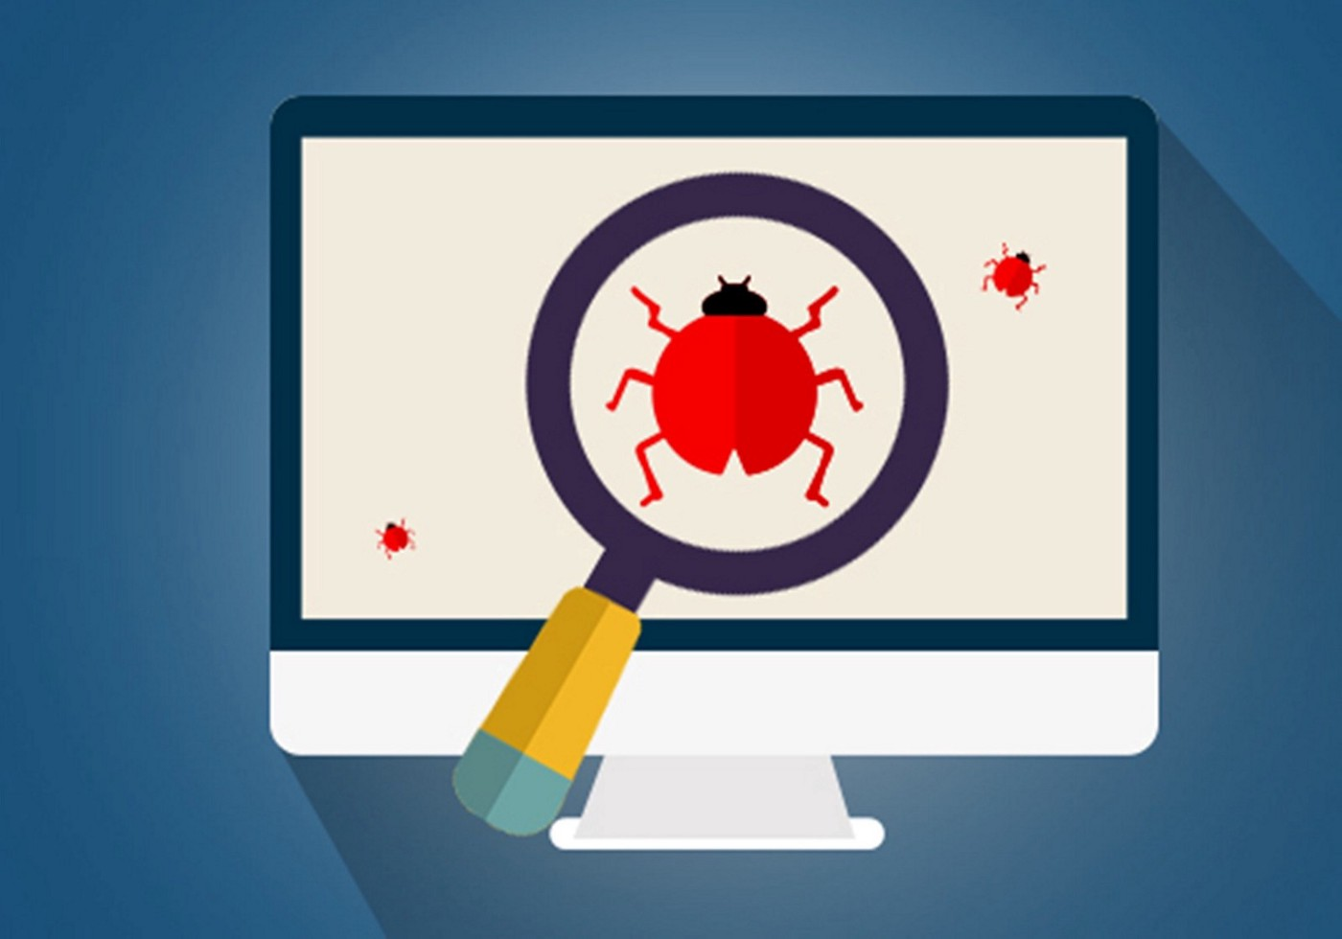
Software Testing
Software testing is a process of executing a program or application with the intent of finding the errors
The process of verifying and validating that a software program or application or product:
Meets the business and technical requirements.
Works as expected.
Can be implemented with the same characteristic
Software Testing is necessary because we all make mistakes. Some of those mistakes are unimportant, but some of them are expensive or dangerous

Slide 5
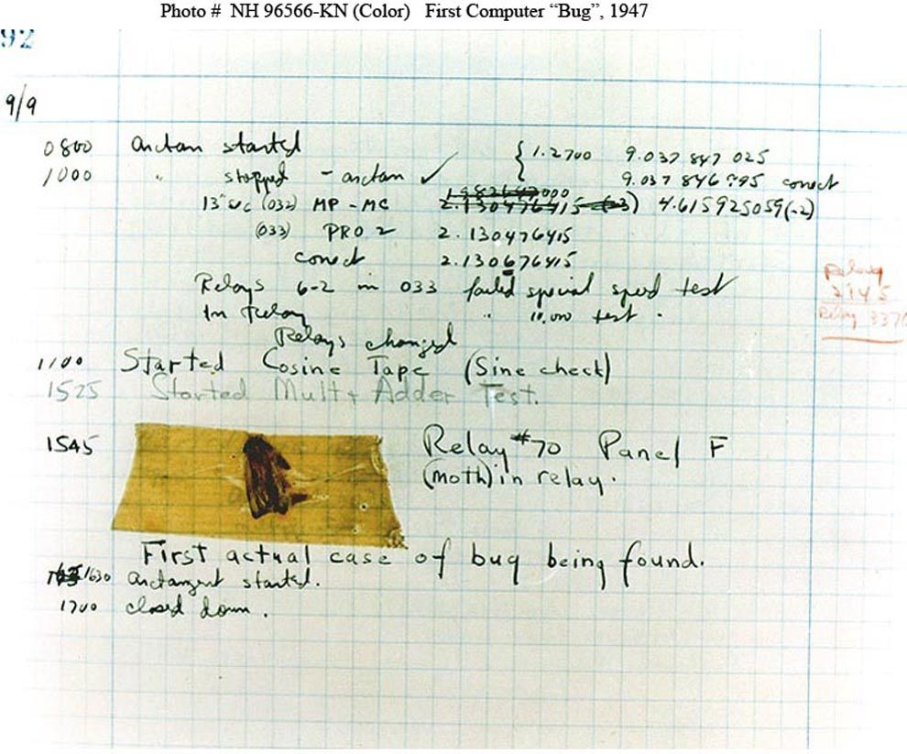
Software Bugs
On September 9, 1947, at 3:45 p.m., Grace Murray Hopper (an American computer scientist and United States Navy rear admiral) records ‘the first computer bug’ in the Harvard Mark II computer’s log-book
The team at Harvard University in Cambridge, Massachusetts, found that their computer, the Mark II, was delivering consistent errors. When they opened the computer’s hardware, they found ... a moth. The trapped insect had disrupted the electronics of the computer.

Slide 6

The Explosion of the Ariane 5
On June 4, 1996, an Ariane 5 rocket launched by the ESA (European Space Agency) exploded just forty seconds after its launch from Kourou in the French Guiana. The rocket was on its inaugural voyage, after a decade of development costing $8 billion and the result of this bug was the loss of $370 million.
The reason behind its failure was an integer Overflow, which is a widespread bug in computer programming. In this case, an attempt was made to set a 64-bit number in 16-bit space.

Slide 7
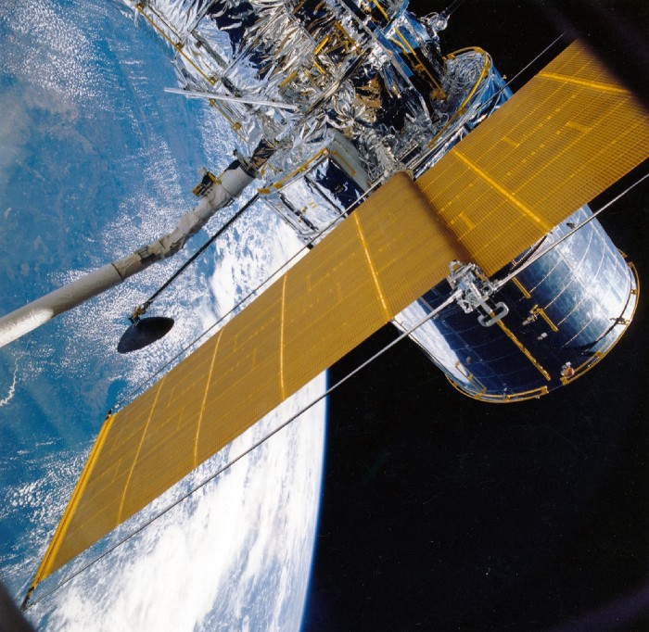
The Metric System and NASA’s Mars Climate Orbiter
On its mission to Mars in 1998 the Climate Orbiter spacecraft was ultimately lost in space. Although the failure bemused engineers for some time, it was revealed that a sub contractor on the engineering team failed to make a simple conversion from imperial units to metric. An embarrassing lapse that sent the $125 million craft fatally close to Mars’ surface after attempting to stabilize its orbit too low.

Slide 8
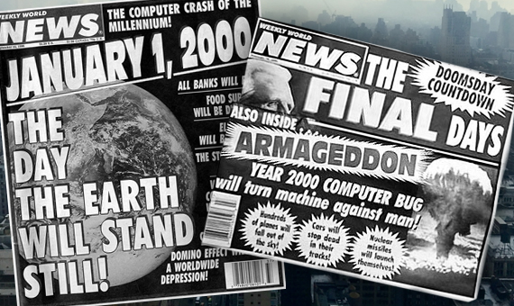
Y2K Bug (1999)
The Millennium bug or Y2K refers to events related to the storage and formatting of calendar data beginning in the year 2000. Problems were predicted because many programs represented four-digit years with only the final two digits, making the year 2000 indistinguishable from 1900.
It affected, for example, to banks that calculate interest rates daily, centers such as nuclear power plants, hospitals, transportation, and a lot of things. Billions of dollars were spent around the world to upgrade computer systems and correct this error.

Slide 9

Gangnam Style music video ‘broke’ YouTube
YouTube’s counter before used a 32-bit integer, which is a unit used to represent data in computer architecture. This 32-bit integer determines the maximum possible views it could count was 2,147,483,647.
The Gangnam Style video exceeded the maximum value, and we got the below famous Gangnam Style YouTube bug.
Nowadays, YouTube uses a 64-bit integer for its video counter, which means videos have a maximum viewer count of 9.22 quintillion.

Slide 10
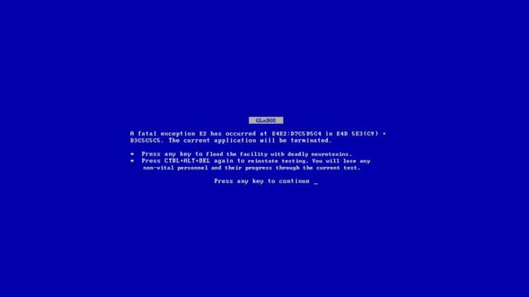

BSOD during the windows 98 presentation
The BSOD or “Blue screen of death” is a blue color error screen displayed on Windows systems following a fatal system error. It shows a system crash, in which the OS has reached a state where it can no longer operate reliably. This is caused by several different problems, such as a crucial process terminating unexpected or a general hardware failure
Bill Gates and thousands of people witnessed the famous BSOD (Blue Screen of Death) live in the presentation of Windows 98.

Slide 11

General Testing Terms
Bug is the result of a coding error
Defect is the difference between expected and actual result in the context of testing
Fault A wrong or mistaken step, process or Data definition in a computed program which causes the program to perform in an unintended or unanticipated manner.
Failure is the inability of a software system or component to perform its required functions within specified performance requirements
A human being can make an error (mistake), which produces a defect(fault, bug) in the program, code or in a document. If a defect in code is executed, the system may fail to do what is should do (or do something it shouldn’t), causing a failure

Slide 12
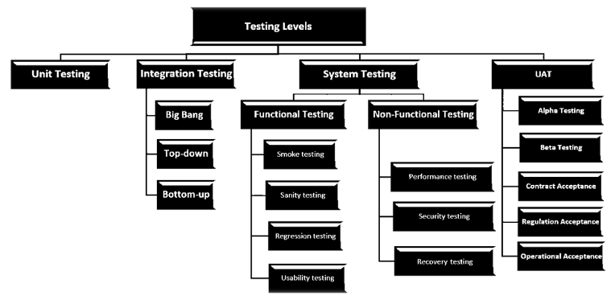
Test Levels

Slide 13
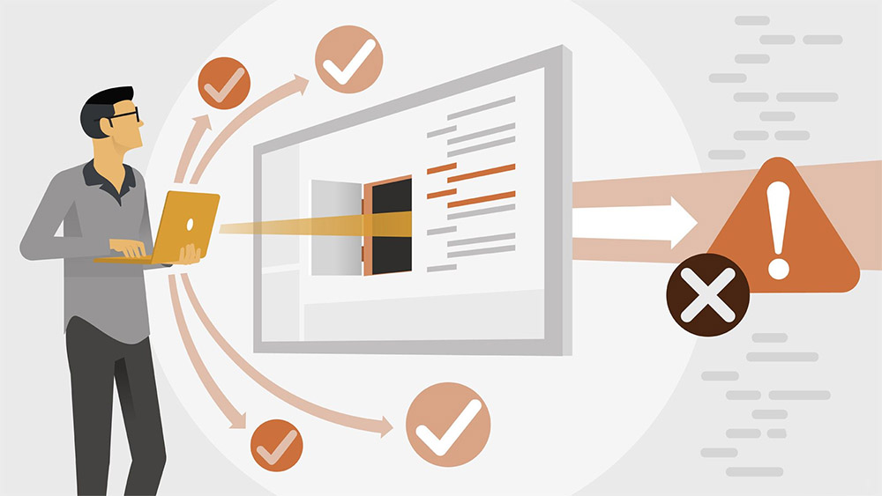
Main Levels of Testing
Unit Testing: To verify a single program or a section of a single program
Integration Testing: To verify interaction between system components (modules).
System Testing: To verify and validate behaviors of the entire system against the original software objectives.

Slide 14
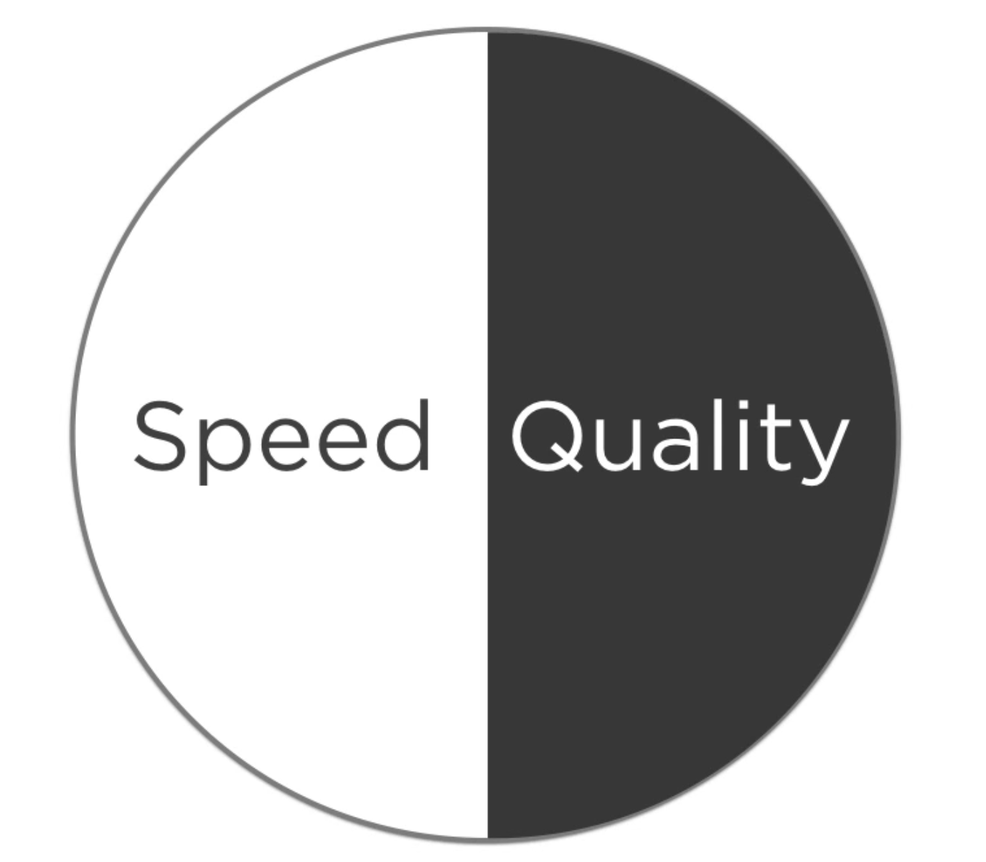
Speed vs Quality

Slide 15
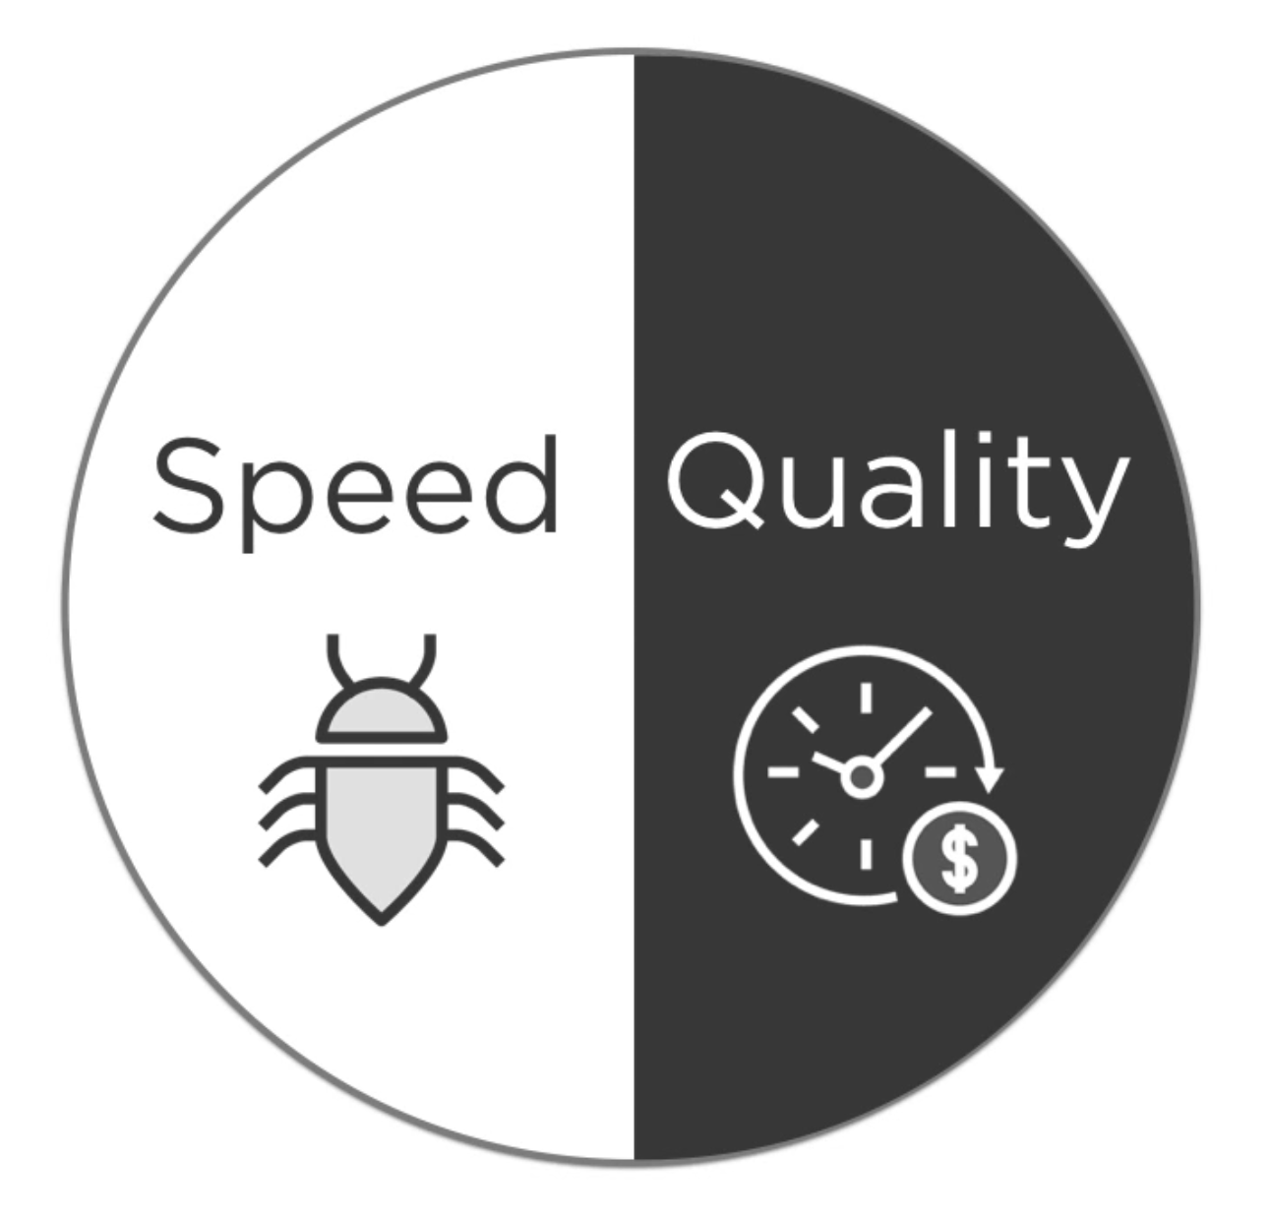

Slide 16
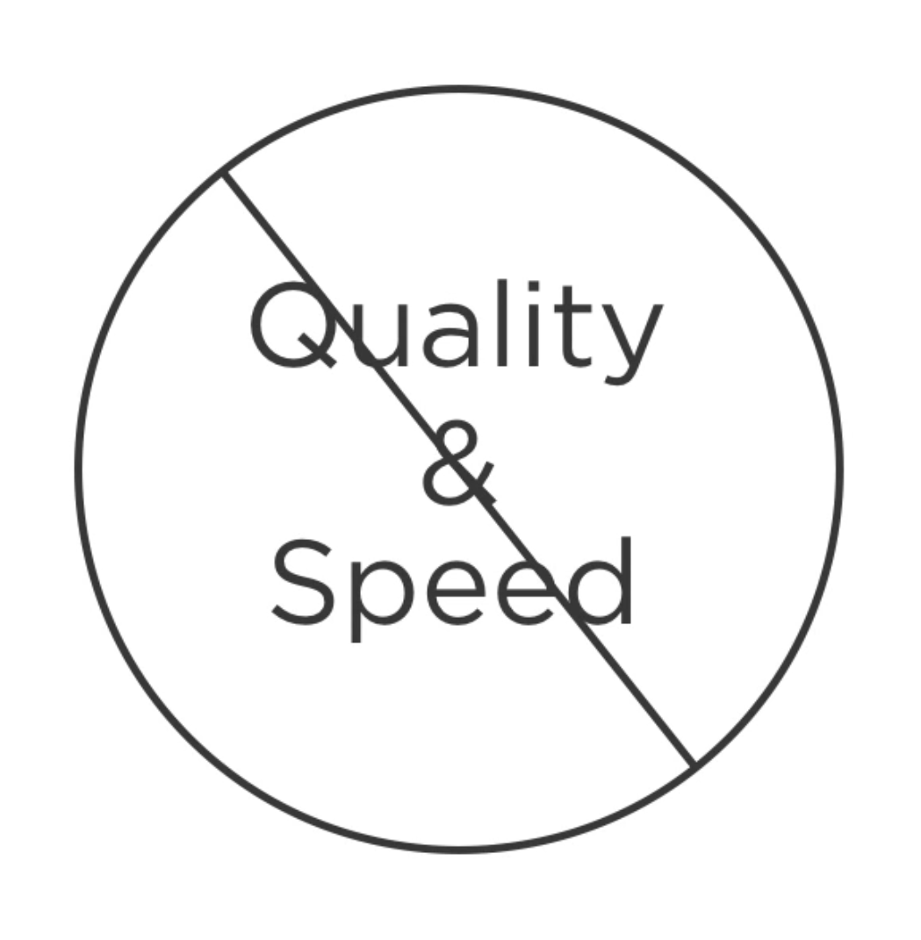

Slide 17
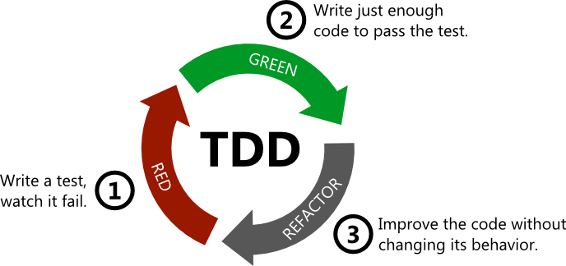
Test-Driven Development
TDD is a process formed by repetition of a short development cycle
The TDD cycle is referred to as the Red, Green, Refactor cycle
TDD is a skill of thinking about the problem you are trying to solve before you actually solve it
Writing your tests before your main code

